Slide 1
CAR CLUB
Online spare booking store
ADARSH JOE
C3GMCA2102

Slide 2
CONTENTS
INTRODUCTION
SCOPE OF THE PROJECT
EXISTING SYSTEM
PROPOSED SYSTEM
FEASIBILITY STUDY
ACTORS
DIAGRAMS
SYSTEM REQUIREMENTS
TABLE SPECIFICATION
SYSTEM TESTING
CONCLUSION
REFERENCES
SCREENSHOTS

Slide 3
INTRODUCTION
There exist online shopping systems for all the products but shops in our areas are not included in the system
we will be able to implement a online shopping and service system for those who want to buy spare parts online
Also provides users to search nearby workshops and access the various services
Actors
Admin
Spare parts shop
Workshop
User

Slide 4
Scope of the project
Order car spare parts from different spare shops
Search spare parts based on car models
Compare similar product with compare option
Real-time tracking of spare parts inventory.
Provide workshops with different services. User can search workshop based on location and view their services.

Slide 5
Existing system
There are several online spare parts booking applications available
No proper system to manage the online spare parts shops that available locally
There is no details about services and details about local workshops
No prebooking options for parts
No direct communication with admin and users for registering complaints

Slide 6
Proposed system
Developed mainly for online spare parts shopping
Includes workshop services
Pre booking system for the currently unavailable products
Search nearby workshops
Product service availability
Category and brands-based products for all vehicles
Register complaints direct to admin

Slide 7
Feasibility study
It is a way to evaluate whether or not a project plan could be successful
Economic feasibility
Technical Feasibility
Behavioral Feasibility
Legal Feasibility

Slide 8
Economical Feasibility
Cost of Development: The project uses Python (Django) and SQLite, which are free and open-source, reducing development costs.
Revenue Generation: The platform can earn revenue through commissions from spare part shops and workshops, and through advertisements.
Market Demand: High demand exists for a system combining spare parts and workshop services, ensuring potential profitability.

Slide 9
Technical Feasibility
Technology Availability: Python (Django) and SQLite are reliable technologies, widely used for building scalable web applications.
Integration: The project can integrate payment gateways and tracking systems easily with existing tools.
Platform Scalability: The system can handle increasing users by upgrading the hosting and database as needed.

Slide 10
Behavioural feasibility
User Acceptance: The project targets users already familiar with online shopping, ensuring easy adoption.
Convenience: Users benefit from a single platform for ordering parts and finding workshop services, which simplifies vehicle maintenance.
Admin Management: The admin has full control over shops, workshops, and reports, improving operational efficiency.

Slide 11
Legal Feasibility
E-commerce Compliance: The platform must comply with regional e-commerce laws, including proper invoicing and taxation.
Data Protection: User data, especially payment information, must be securely stored to comply with privacy regulations like GDPR or CCPA.
Contracts and Agreements: Agreements with shops and workshops must define terms for service quality, commissions, and liabilities.

Slide 12
Hardware and Software Requirements
1.HARDWARE REQUIREMENTS
Processor : Dual Core
Speed : 2 GHz
RAM : 300 mb of RAM space
Hard Disk : 5 GB of Hard disk space
2.SOFTWARE REQUIREMENTS
Operating System : Windows 7 and above
Front End : HTML, CSS, JavaScript
Back End : SQLite
Programming Language : Python Django
Development Platform : Visual Studio Code

Slide 13
Actors
Admin
Spare parts shop
Workshop
User

Slide 14
Admin
Login
Approve/Reject Spare shops
Approve/Reject Work shops
View Spare part shops
View Workshops
Add category
Add brand
Add model
View complaints
Write reply
View sales report
Receive share
View category
View brand
View model
Logout

Slide 15
Spare parts shop
Login
Add spare parts
View spare parts
View orders
Approve/Reject order
Add tracking details
View pre booking
View rating and review
View payments
View profile
Update profile
Logout

Slide 16
Workshop
Login
Add service
View service
Update service
View rating and reviews
View profile
Update profile
Logout

Slide 17
User
Login
View spare parts
Order spare parts
Delete order
View reply
View order status
Pre booking
View pre booking status
Add payment
Rate and review
Search workshops
View services
Write complaint
View and update profile
Logout

Slide 18
DIAGRAMS
USECASE DIAGRAM
ACTIVITY DIAGRAM
SEQUENCE DIAGRAM
E-R DIAGRAM
DATA FLOW DIAGRAM
HIERARCHICAL DIAGRAM

Slide 19
Usecase Diagram
Use case diagram is a behavioural diagram that shows a set of use cases and actors and their relationship. It is association between the use cases and actor. An actor represents a real world object. Primary actor - sender, secondary actor – receiver

Slide 20
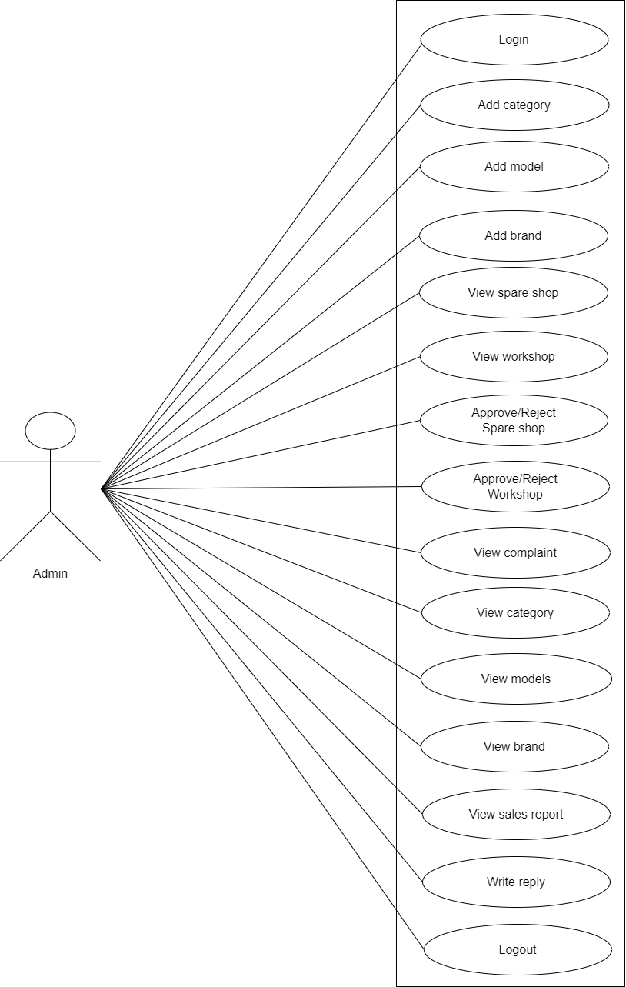

Slide 21
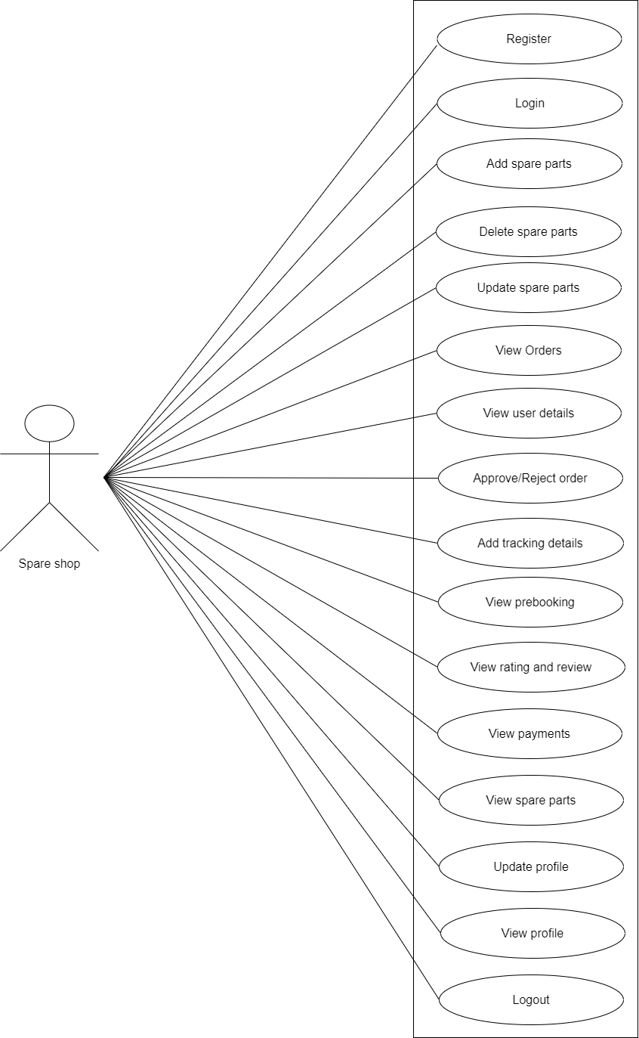

Slide 22
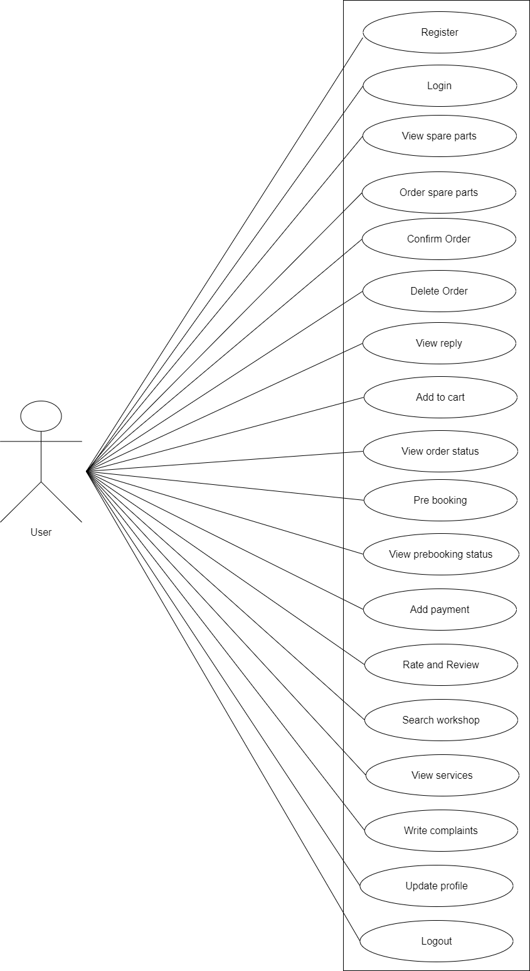

Slide 23
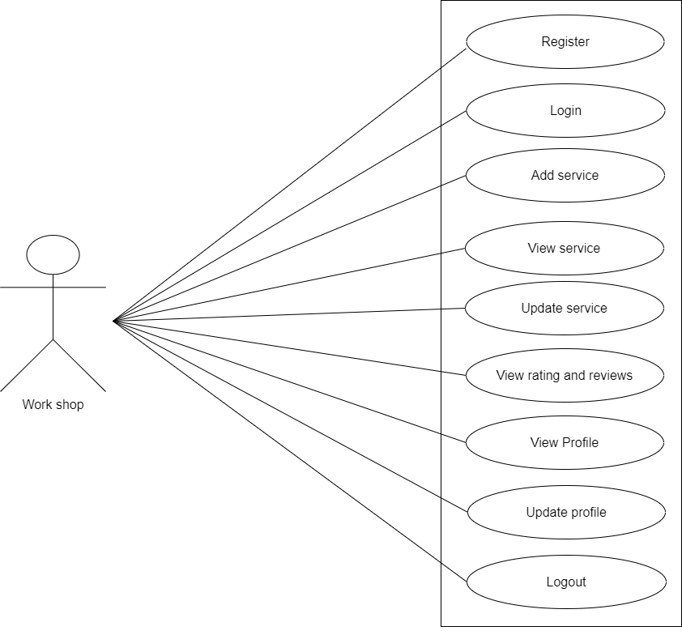

Slide 24
Activity Diagram
Activity diagrams show the overall flow of control.
The basic purposes of activity diagrams are similar to other diagrams. It captures the dynamic behavior of the system. Other diagrams are used to show the message flow from one object to another but activity diagram is used to show message flow from one activity to another.

Slide 25
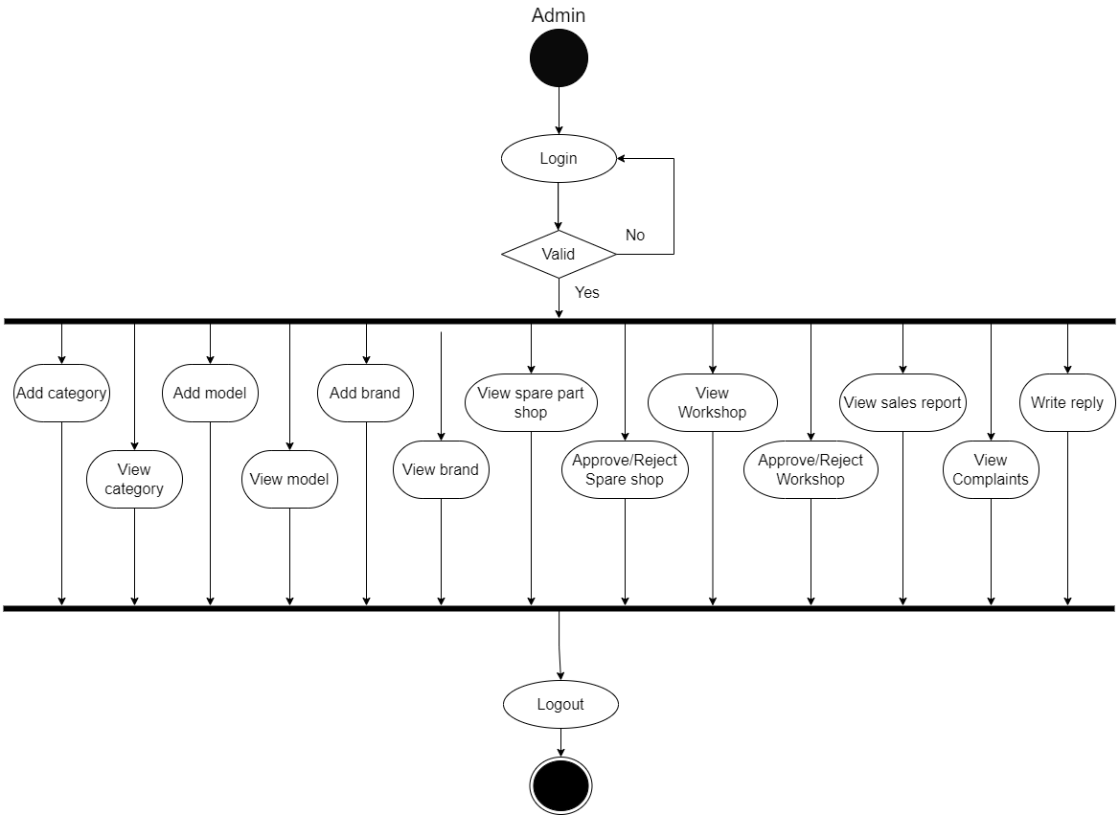
ADMIN

Slide 26
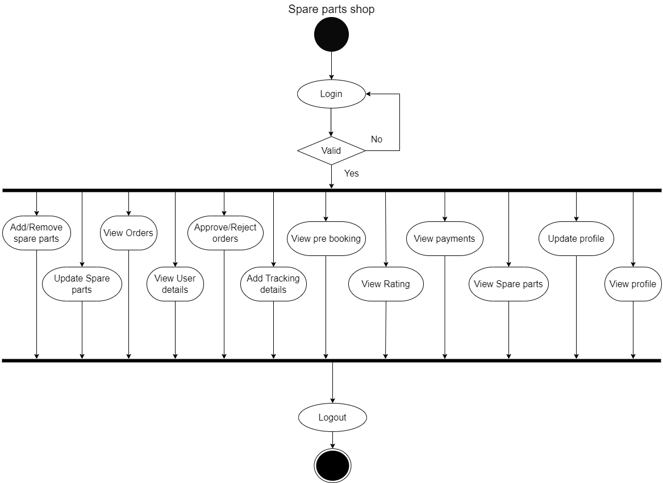
SPARE PARTS SHOP

Slide 27
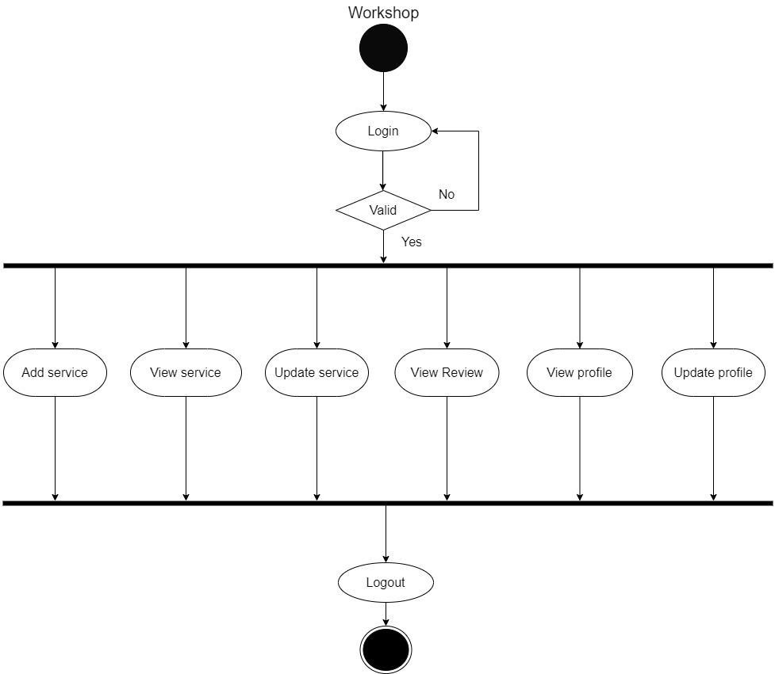
WORKSHOP

Slide 28
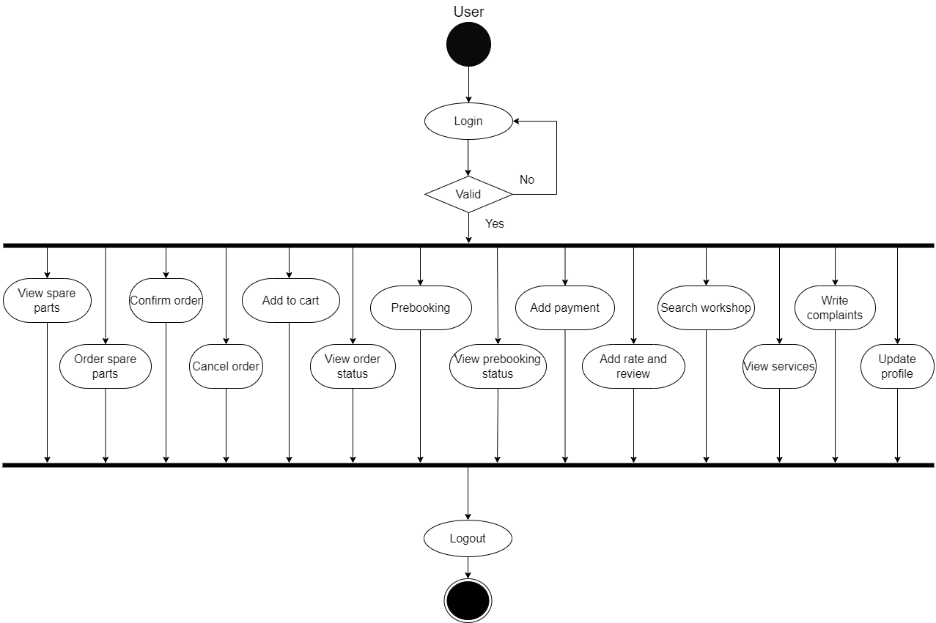
USER

Slide 29
Sequence Diagram
Sequence diagrams are an easy and intuitive way of describing the behavior of a system by viewing the interaction between the system and its environment.
A sequence diagram shows an interaction arranged in a time sequence.
It shows the objects participating in the interaction by their life lines and the messages they exchange, arranged in a time sequence.
A sequence diagram has two dimensions: a vertical dimension represents time, horizontal dimension represents different objects

Slide 30
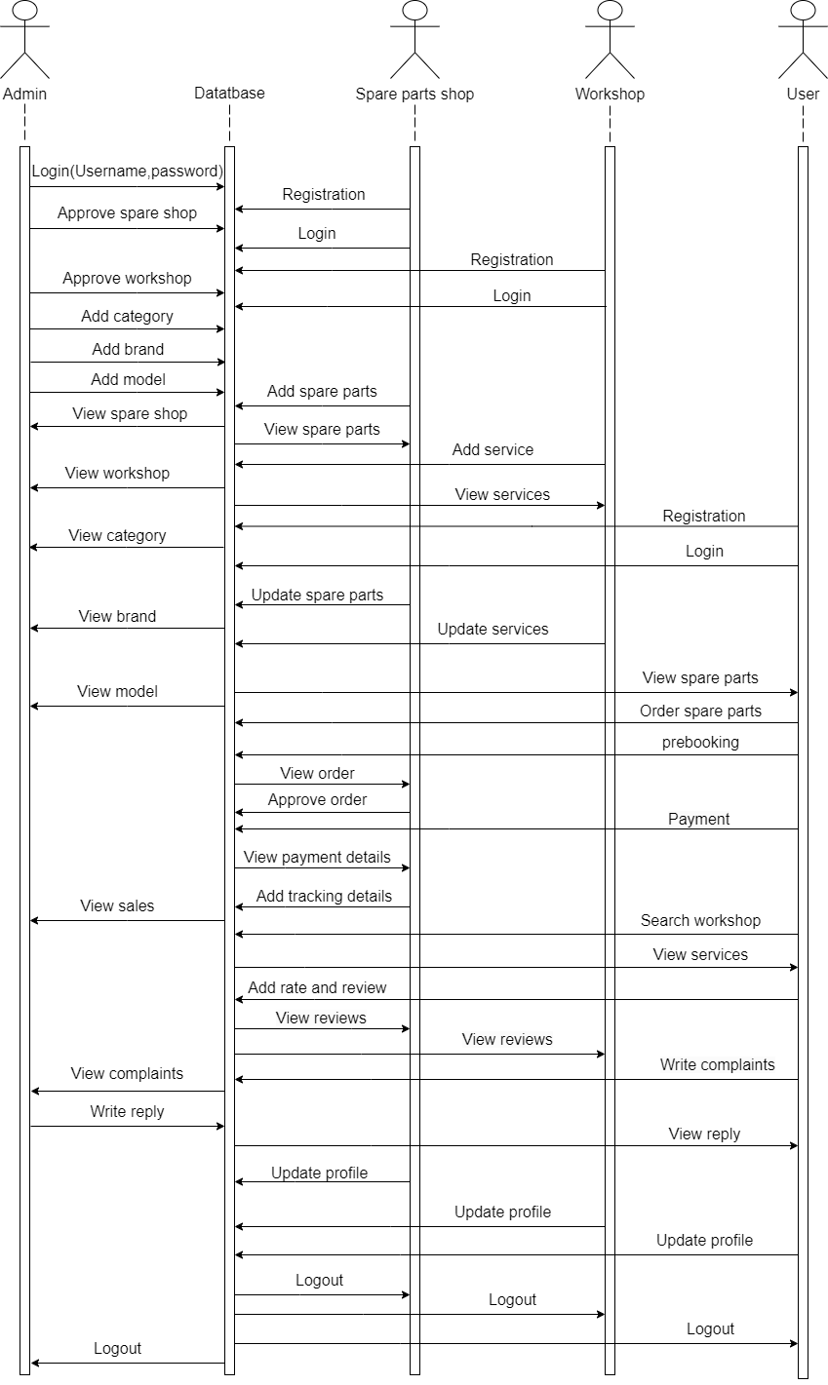
Sequence Diagram

Slide 31
DESIGN

Slide 32
E-R Diagram
An entity-relationship diagram is a data modeling technique that creates a graphical representation of the entities, and relationship between entities, within an information system
Entities are the “things” about which we seek information
Attributes are the data we collect about entities.
Relationships provided the structure needed to draw information from multiple entities.

Slide 33
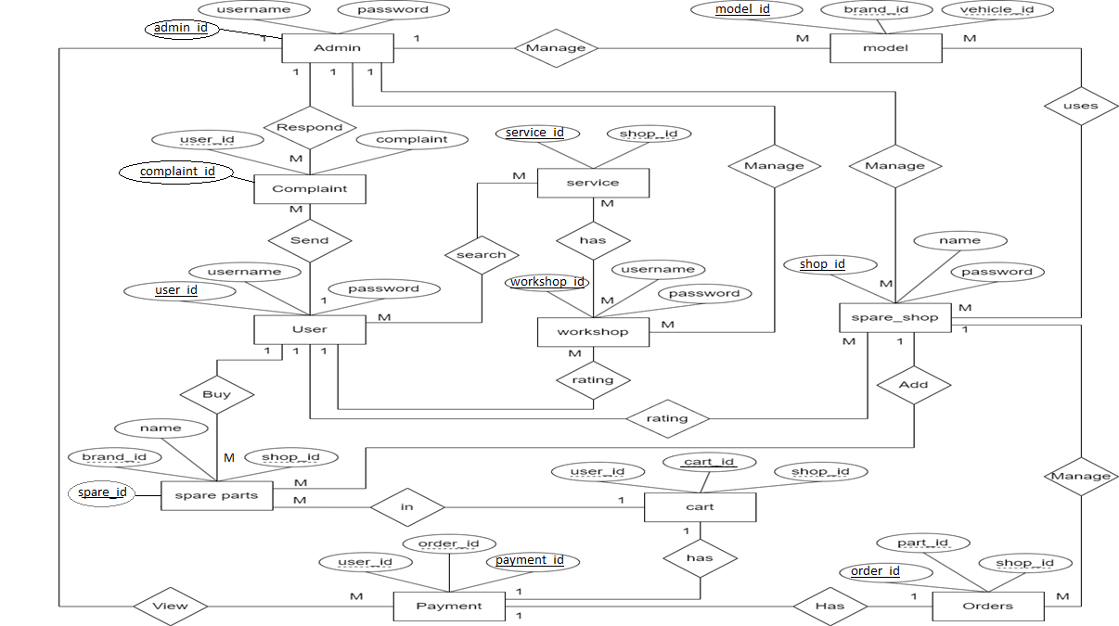

Slide 34
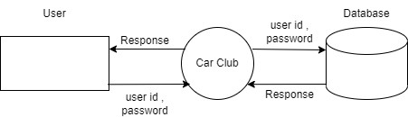
Data Flow Diagram
A data flow diagram is a graphical technique that depicts data flow and transforms that are applied as data move from input to output.
The DFD is used to represent increasing information flow and functional details.
DFD level 0:

Slide 35
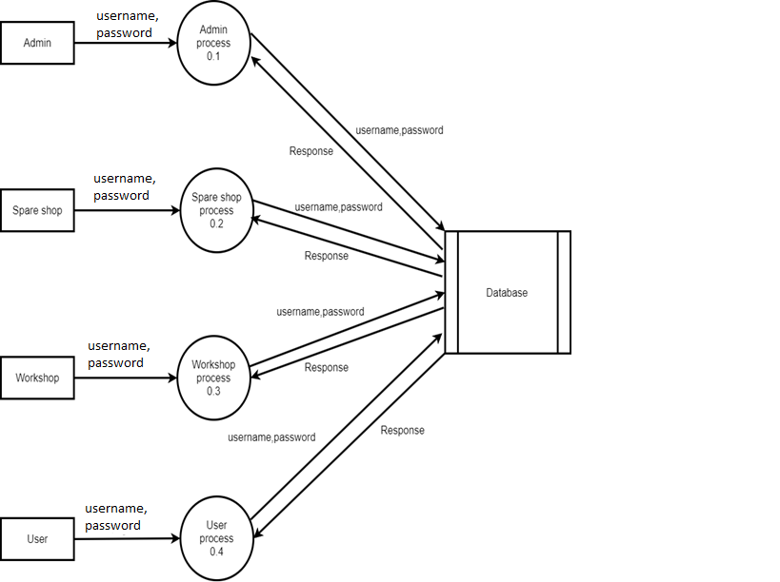
DFD level 1:

Slide 36
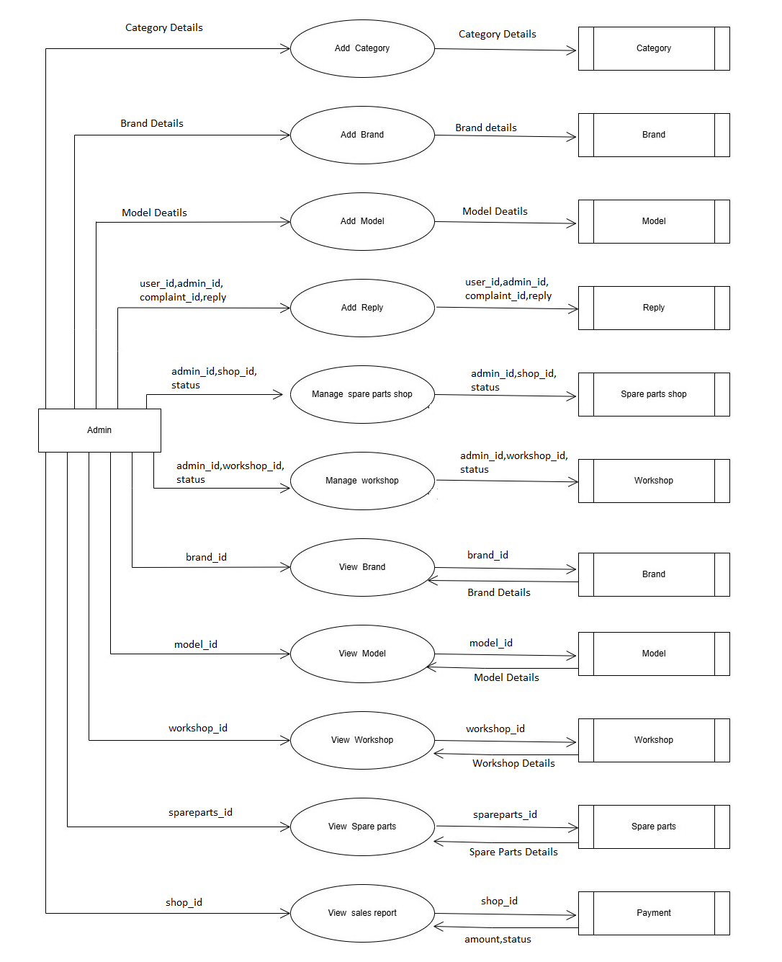
Level 2:Admin

Slide 37
Category Details : category_id , category, vehicle_id
Brand Details : brand_id, brand_name, vehicle_id
Model Details : model_id, model_name, brand_id, vehicle_id
Spare parts Detail : spare_id, path, part_name ,details, price,stock, brand_id , vehicle_id, shop_id, category_id
Workshop Details : workshop_id ,logo , shop_name, phone,email,username, password ,address , status , place, district_id,proof

Slide 38
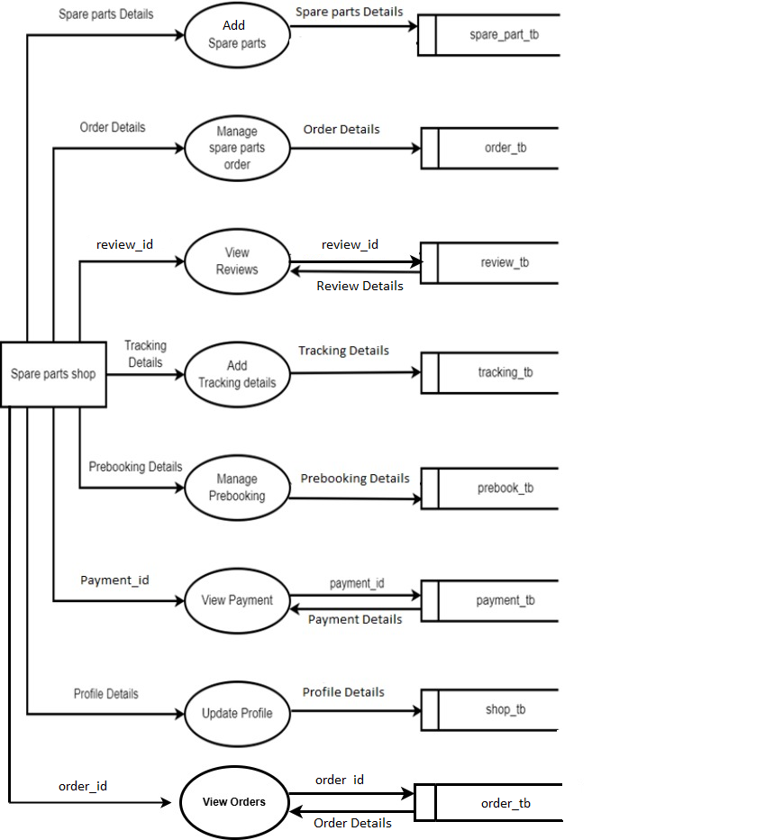
Level 2:Spare shop

Slide 39
Spare parts Detail : spare_id, path, part_name ,details, price,stock, brand_id , vehicle_id,shop_id, category_id
Order Detail : shop_id, phone,address, count,total_price, status, part_id,user_id,date
Review Details: spare_shop_id,user_id,review,part_id,date
Tracking Details :tracking_id,tracking_details,date,order_id,time
Prebooking Details : prebook_id, part_id , shop_id, user_id ,count, date , status,time
Payment Details : shop_id , amount , transaction_key , order_id, date, user_id , status
Profile Details :shop_id ,logo , shop_name, phone,email,username, password ,address , status , place, district_id,proof

Slide 40
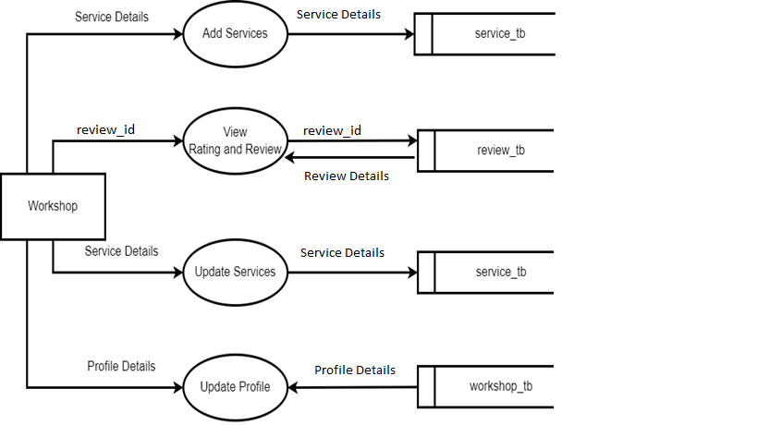
Level 2:Workshop

Slide 41
Service Detail: workshop_id, service,description, status,shop_id , service_img
Review Detail: workshop_id,user_id,review,date
Profile Details : workshop_id ,logo , shop_name, phone,email,username, password ,address , status , place, district_id,proof

Slide 42
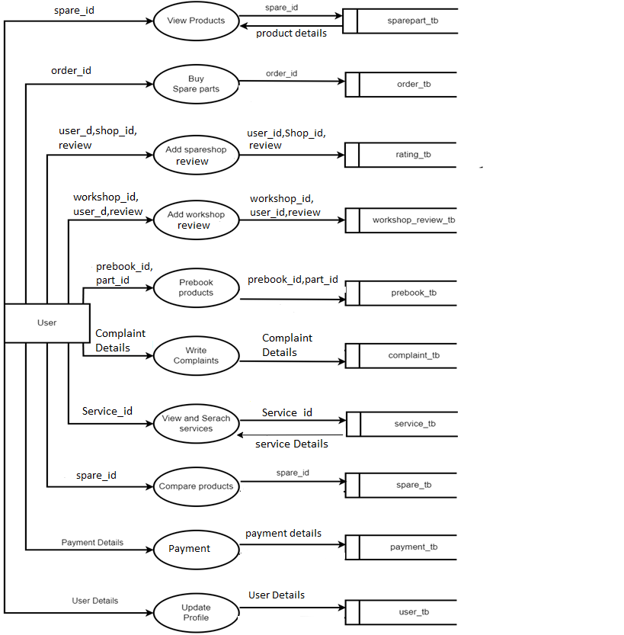
Level 2:User

Slide 43
Service Detail : workshop_id, service,description, status,shop_id , service_img
Payment Details : shop_id , amount , transaction_key , order_id, date, user_id , status
Spare parts Detail : spare_id, path, part_name ,details, price,stock, brand_id , vehicle_id, shop_id, category_id
Order Detail : shop_id , phone , address, count , total_price, status, part_id ,user_id ,date
User Detrails : Profile Details : user_id ,logo , phone, email , username , password ,address , place , district_id

Slide 44
Hierarchical Diagram
The hierarchical diagram is a technique for representing the modules of a system as a hierarchy and for documenting each module.
It was used to develop requirements, construct the design, and support implementation of an expert system to demonstrate and verify the system to demonstrate and verify the system. Structure charts can be used to display several types of information.

Slide 45
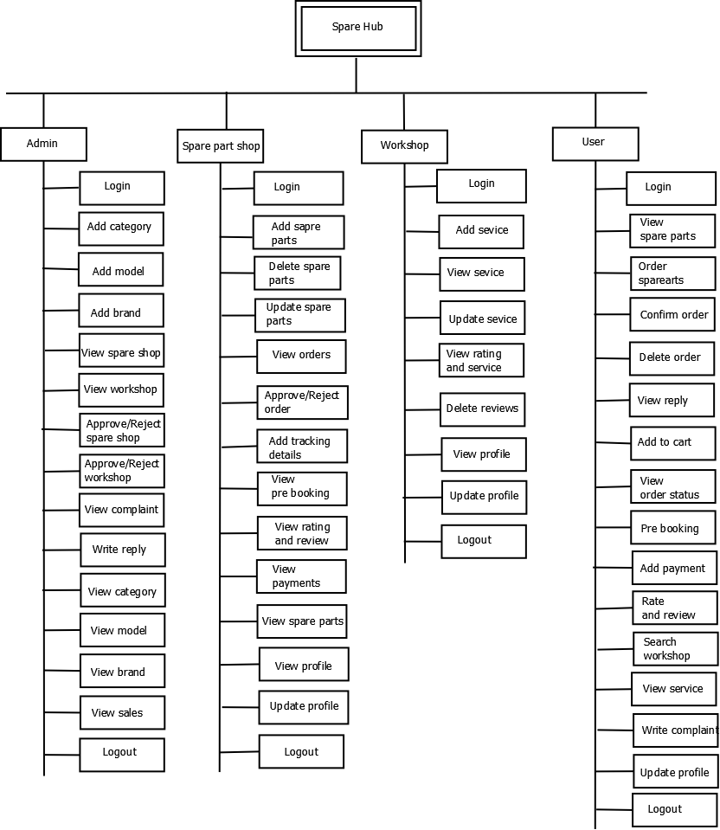
Hierarchical Diagram

Slide 46
Table specifications
Table Name | Description
admin_tb | Store admin details.
user_tb | Store user details.
Sparepart_tb | Store spare parts details
order_tb | Store spare parts order details
complaint_tb | Store user complaints
service_tb | Store workshop service details
cart_tb | Store cart spare parts details
model_tb | Store car models details
workshop_tb | Store workshop details
spareshop_tb | Store spare shop details

Slide 47
Admin Table
Field | DataType | Description
id(*) | Integer | Admin ID
username | Varchar(20) | Username
password | Varchar(20) | Password

Slide 48
User Table
Field | DataType | Description
userid(*) | Integer | User Id
path | Varchar(50) | Photo
name | Varchar(20) | Name
gender | Varchar(20) | Gender
address | Varchar(20) | Address
email | Varchar(20) | Mail ID
user_name | Varchar(20) | User name
password | Varchar(20) | Password

Slide 49
Spare part Table
Field | DataType | Description
part_id(*) | Integer | Part ID
shop_id(**) | Integer | Shop ID
part_name | Varchar(20) | Part name
price | Varchar(20) | Price details
stock | Varchar(20) | Stock details
details | Varchar(20) | Product details

Slide 50
Order Table
Field | DataType | Description
Id(*) | Integer | Order ID
phone | Varchar(20) | Phone number
address | Varchar(20) | Address
count | Varchar(20) | Total number
part_id | Integer | Part ID
shop_id | Integer | Shop ID
time | Varchar(20) | Ordering time
prebook_id | Integer | Pre booking ID

Slide 51
Complaint Table
Field | DataType | Description
id | Integer | User Id
subject | Varchar(20) | Subject
complaint | Varchar(50) | Complaint details
date | Varchar(20) | Date
user_id | Integer | User ID

Slide 52
Service Table
Field | DataType | Description
id(*) | Integer | Service ID
service | Varchar(20) | Service details
description | Varchar(200) | Service discription
status | Varchar(20) | Service availability
shop_id | Integer | Shop ID
image | Varchar(100) | Images

Slide 53
Cart Table
Field | DataType | Description
id(*) | integer | Cart ID
phone | Varchar(20) | Phone number
address | Varchar(20) | Address
count | Integer | Count of product
total_price | Varchar(20) | Total price
part_id | Integer | Part Id
user_id | Integer | User Id
shop_id | Integer | Shop id

Slide 54
Model Table
Field | DataType | Description
Id(*) | Integer | model ID
model_name | Varchar(20) | Vehicle model name
brand_id | Integer | Vehicle brand id
vehicle id | Integer | vehicle ID

Slide 55
Pre-book Table
Field | DataType | Description
Id | Integer | Pre booking ID
Part id | Integer | Spare part ID
Shop id | Integer | Spare part shop ID
User id | Integer | User ID
Count | Varchar(20) | Total number
Date | Varchar(20) | Date
Status | Varchar(20) | Order status
Time | Varchar(20) | Time of booking

Slide 56
Workshop Table
Field | DataType | Description
Id(*) | Integer | Workshop ID
logo | Varchar(30) | Workshop logo
shop_name | Varchar(30) | Workshop name
phone | Varchar(20) | Phone number
email | Varchar(20) | email
address | Varchar(30) | Workshop address
username | Varchar(20) | User name
password | Varchar(20) | Password
proof | Varchar(20) | Proof

Slide 57
Spare shop Table
Field | DataType | Description
id | Integer | Spare shop id
logo | Varchar(20) | Spare shop logo
shop name | Varchar(20) | Spare shop name
address | Varchar(30) | User ID
phone | Varchar(20) | Phone number
email | Varchar(20) | Email
username | Varchar(20) | User name
password | Varchar(20) | Password

Slide 58
TESTING
1. Running the program to identify any errors that might have occurred while feeding the program into the system.
2. Applying the screen formats to regulate users to extend, so that the screens are comprehensible to the user.
3. Presenting the formats to the administration for the purpose of obtaining approval and checking if any modification has to be done. Obtaining feedbacks from users and analyzing the scope for improvement.
4. Checking the data accessibility from the data server and whether any improvement is needed or not.

Slide 59
Unit Testing
No: | Test Scenario | Expected Result | Observed Result | Result
1. | Enter wrong user name and pass word. | Display login form again with a warning message. | Message displayed. | Pass
2. | Enter correct user name and wrong password. | Display login form again with a warning message. | Message displayed. | Pass
3. | Enter correct user name and password. | Users can login into the system. | Appropriate home page is displayed. | Pass
4. | Press login button without filling the user name and password. | Display a warning message to fill the fields. | Warning message is displayed. | Pass
Login form

Slide 60
No: | Test Scenario | Expected Result | Observed Result | Result
1 | Form displayed. | Display the registration form. | Form loaded | Pass
2 | Enter the name in integers. | Display an invalid message. | Invalid message displayed | Pass
3 | Enter the mobile number in characters. | Display an invalid message. | Invalid message displayed. | Pass
4 | Enter the mobile number more than and less than 10 integers. | Display an invalid message. | Invalid message displayed. | Pass
5 | Click the save button without filling the details | Display a warning message to fill the details. | Warning message displayed. | Pass
6 | Click on save button with filled fields. | Accept the details. | Registration successfully done. | Pass
7 | Click cancel button | Clear all fields to blank | All fields cleared. | Pass
Registration form

Slide 61
Integration Testing
No | Input/procedure | Expected Result | Actual Result | Pass/Fail
1. | Check the value pass between different forms are appropriate format | Appropriate operations of different forms. | Same as expected. | Pass

Slide 62
System Testing
No | Input/procedure | Expected Result | Actual Result | Pass/Fail
1. | Check whether indented output is obtained. | All operations are carried out properly. | Same as expected. | Pass

Slide 63
Validation Testing
Validation testing ensures that the software meets the specified requirements and provides the intended functionality for its users.
It verifies whether the software fulfills the user's needs and is fit for its intended purpose.
Also known user acceptance testing(UAT)

Slide 64
Implementation
Overview
Turning the design into a working system after thorough testing.
Ensuring the system meets all specifications.
Implementation Steps
Testing programs and updating.
Fixing errors.
Creating tables with actual data.
Making changes with actual data.
Running the new system alongside the existing one (Parallel Run).
Training users.

Slide 65
Technologies Used
Tool: Visual Studio Code 1.72.0
Language: Python 3.10
Framework: Django 3.0.5
Database: SQLite
Web Server: Apache
Scripting: HTML, JavaScript, CSS, Bootstrap

Slide 66
Future Enhancement
AI-Powered Recommendations:
Use machine learning to recommend spare parts based on user preferences , vehicle history, or frequently searched items.
Provide personalized offers and discounts.
Mobile Application:
Develop a dedicated mobile app for "CAR CLUB" to enhance accessibility and ease of use.
Enable push notifications for updates and promotional offers

Slide 67
Workshop Booking System:
Allow users to book workshop appointments online.
Provide estimated service times and pricing details.
Integration with Vehicle Maintenance Logs:
Let users maintain a digital record of their vehicle's maintenance history.
Provide reminders for service or part replacement based on mileage or time.
Subscription Plans:
Offer subscription-based services for regular maintenance, part replacements, or premium workshop access.
Provide exclusive deals and priority support to subscribers

Slide 68
References
REFERENCE BOOKS
Roger. S. Pressman, “Software Engineering” Tata McGraw Hill, Fifth Edition, Year 2004.
Abraham Silberschatz, “Database System Concepts”, Henry F Korth ,S Sudarshan Sixth edition, Year 2011
Alan Forbes, "The Joy of PHP", Plum Island, Fifth Edition, Year 2012
WEBSITES
http://www.w3schools.com
http://www.stackoverflow.com
http://www.codeproject.com
Other References
https://boodmo.com/

Slide 69
Conclusion
Car club has been developed, tested, documented, and implemented successfully. The main objective of the system was brought in to effect. The system is developed in Python Django as front-end tool and SQLite as backend tool. The important benefits that have been found out through the implemented system are:
User friendly.
Simplified operation.
Reduced processing time.
Accurate result providing.
Increases accuracy.
Any system that has been used for several years gradually decades and becomes less effective because of the changes in environment to which it has to adopt. For a time, it is possible to overcome problems by appending the need of fundamental changes

Slide 70
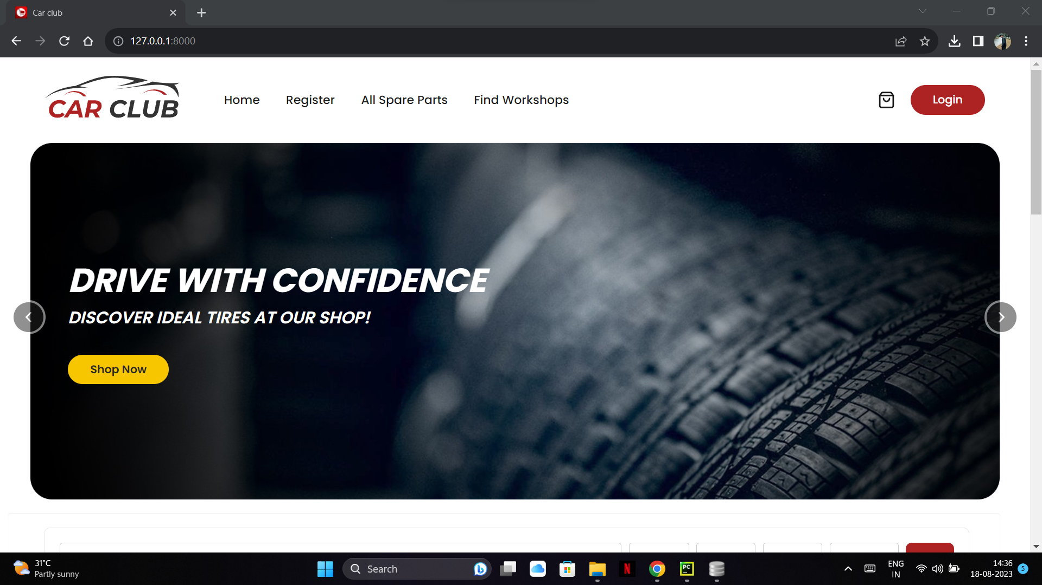
SCREENSHOTS
Home

Slide 71
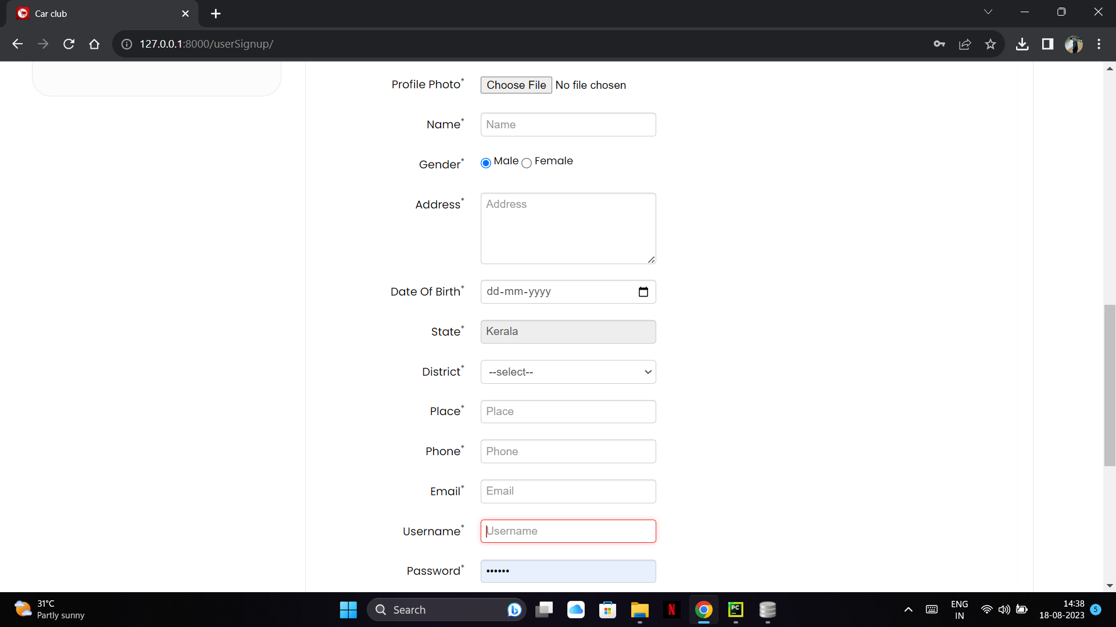
User registration

Slide 72
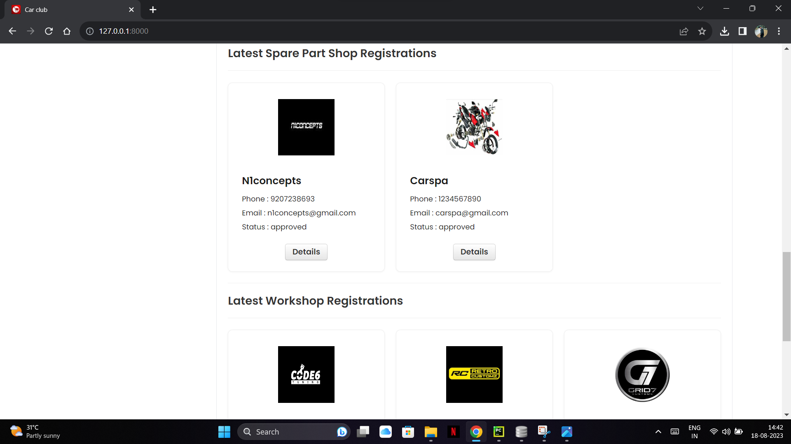
Approve or Reject shops

Slide 73
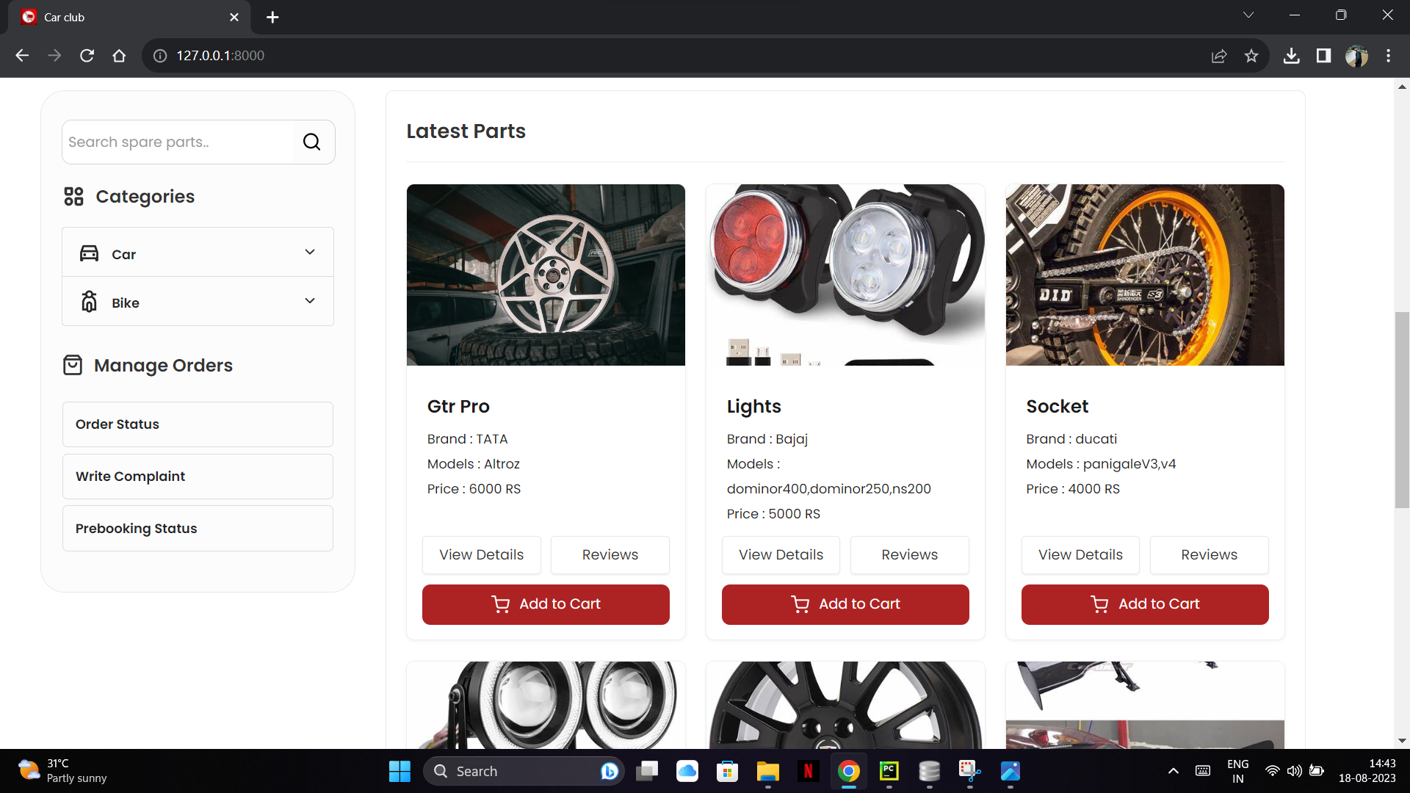
Order Products

Slide 74
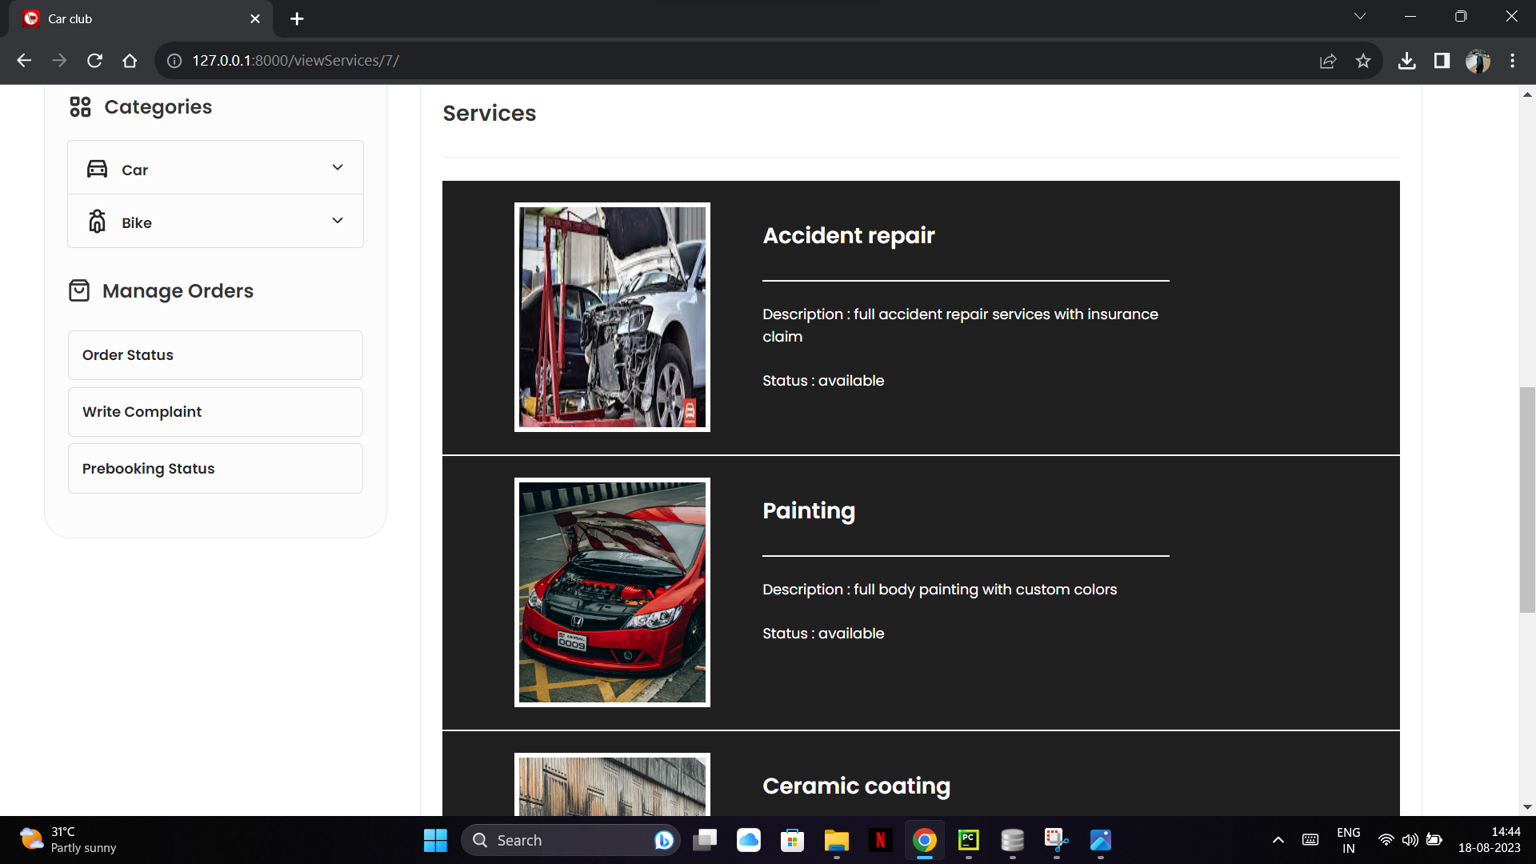
View workshop services

Slide 75
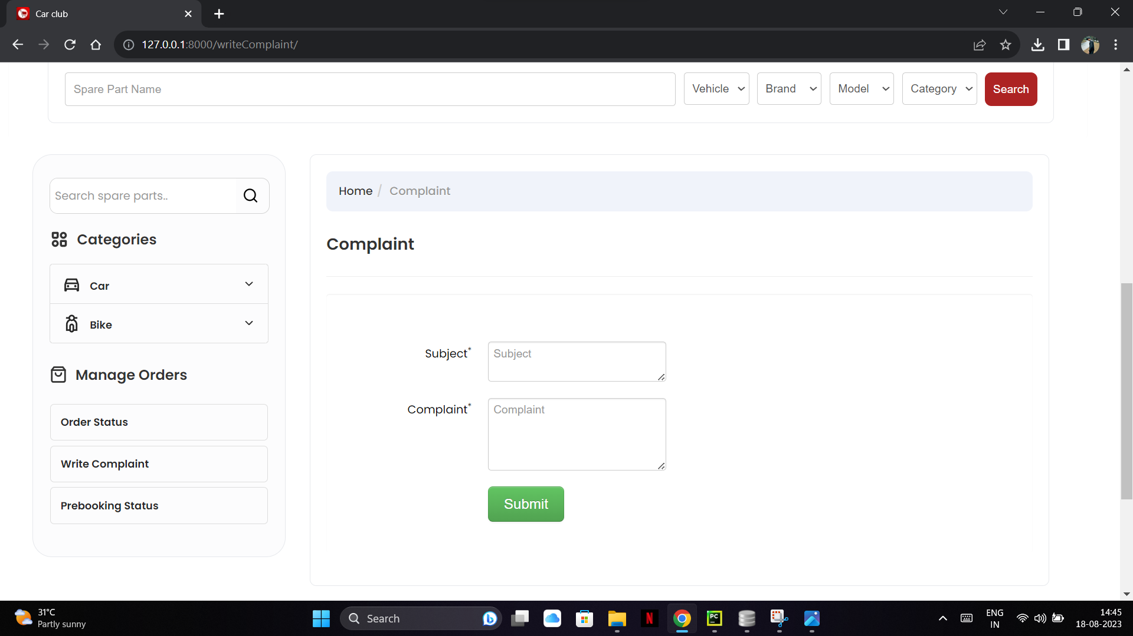
Write complaints

Slide 76
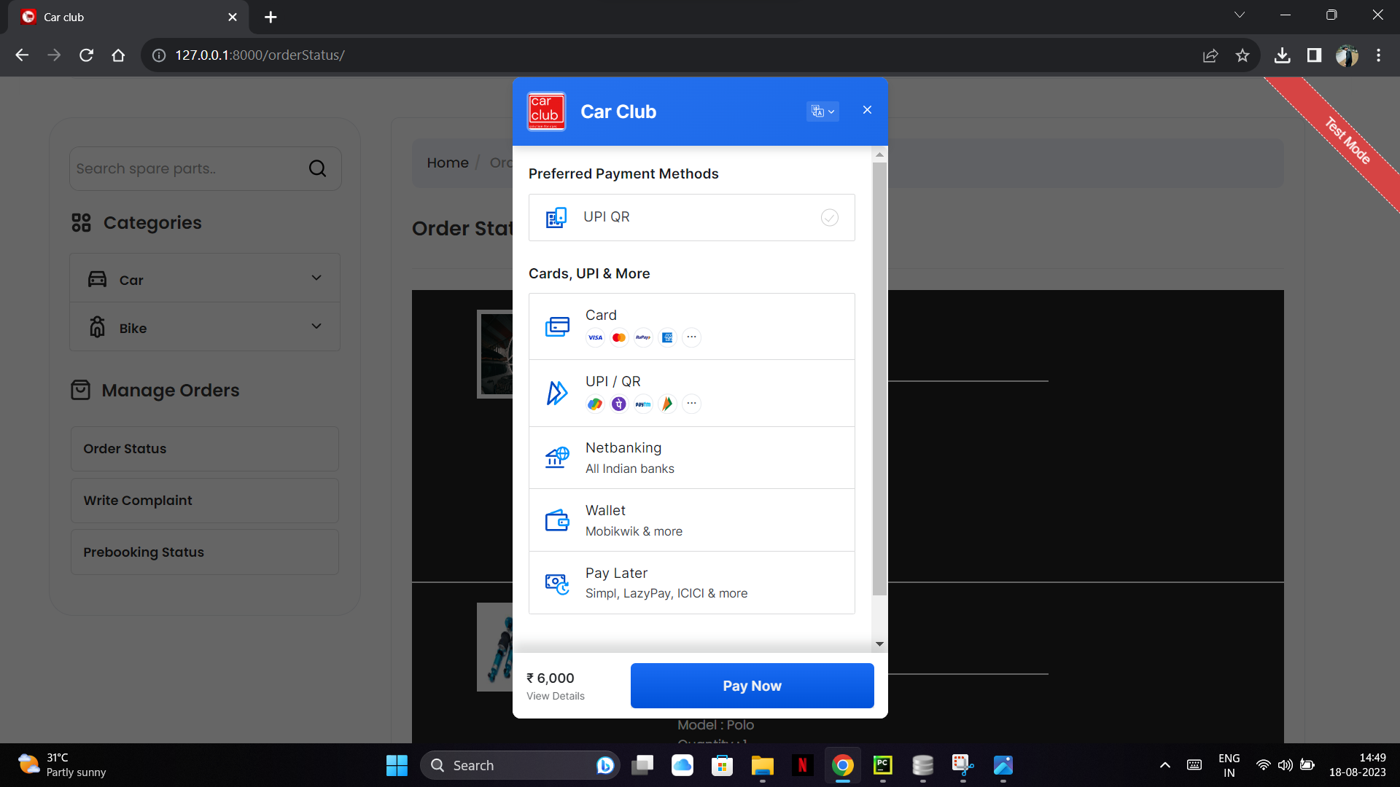
Payment

